Slide 1



Slide 2
STEM Icebreaker
Each time a question comes up, write your answer down on your whiteboard.
You will have 30s per slide
Still participate after you have been knocked out – you just wont be involved in the competition

Slide 3

80% Question
90% Question

Slide 4
Question 1
If a motor needs 4J of energy to operate, and the power supply has an efficiency of 80%, how much input energy is required? (J – Joules, the unit of energy)

Slide 5
Answer
5J

Slide 6

60% Question
75% Question

Slide 7
Question 2
Which gas makes up the majority of our atmosphere?

Slide 8
Answer
Nitrogen

Slide 9
40% Question
50% Question

Slide 10
Question 3
Bob runs at 5mph for 2 hours. Dave runs at 8mph for 1.5hours. Who travels further and by what distance?

Slide 11
Answer
Dave, 2 miles more

Slide 12
30% Question

Slide 13
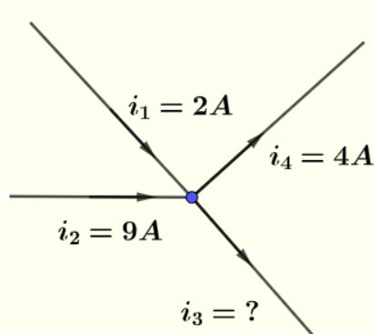
Question 4
What is the outputted current?

Slide 14
Answer
7 Amps

Slide 15
20% question
10% Question

Slide 16
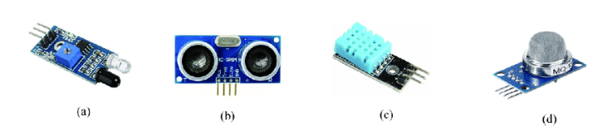
Question 5
Which of these sensors is used to measure distance?

Slide 17
Answer
B (Ultrasound)

Slide 18
10% Question
5% Question

Slide 19
Question 6
What is an LED and why do we use them?

Slide 20
Answer
Light Emitting Diode
Only allow current to flow one way
Prevent catastrophic damage to system if current was to flow the wrong way

Slide 21
1% Question
1% Question

Slide 22
Question 7
What does clock speed mean and what is the clock speed on the Arduino Uno?

Slide 23
Answer
Number of computer cycles a CPU can do in a second.
16MHz

